Slide 1
SAVING OUR NEIGHBORHOOD
NEGATIVE TRAFFIC IMPACTS
Notes:
My name is Art O’Connor
I live at 10985 Dryden Drive
We are just 2 parcels away from this project

Slide 2
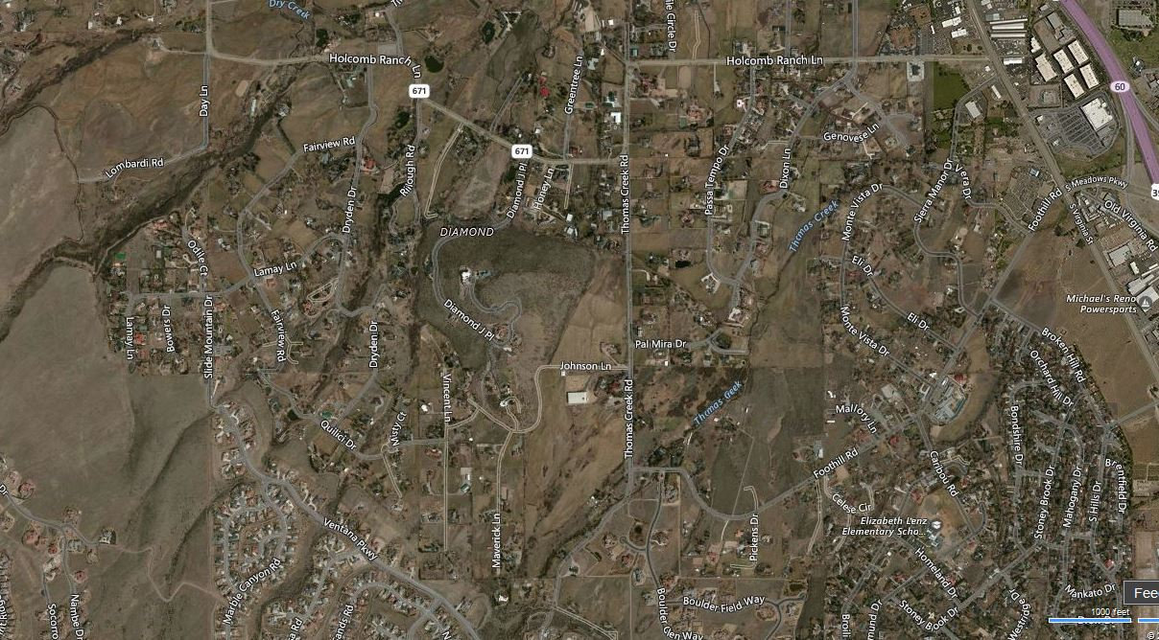
OUR NEIGHBORHOOD
Notes:
Use pointer to outline area. Discuss single entrance.
Dryden begins at Holcomb Ranch Road and terminates at Quilici.

Slide 3
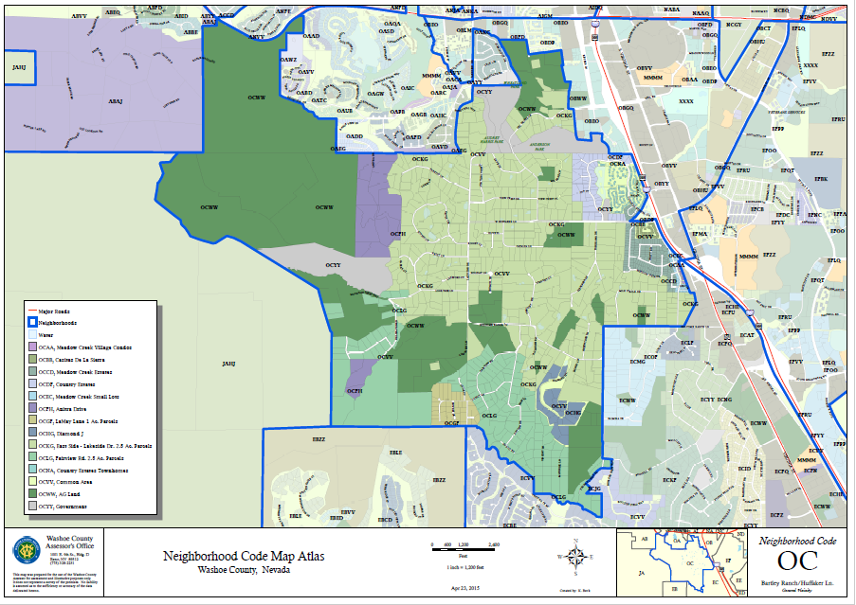
OC NEIGHBORHOOD
Notes:
138 parcels served by Dryden Drive, which is the only public access.

Slide 4
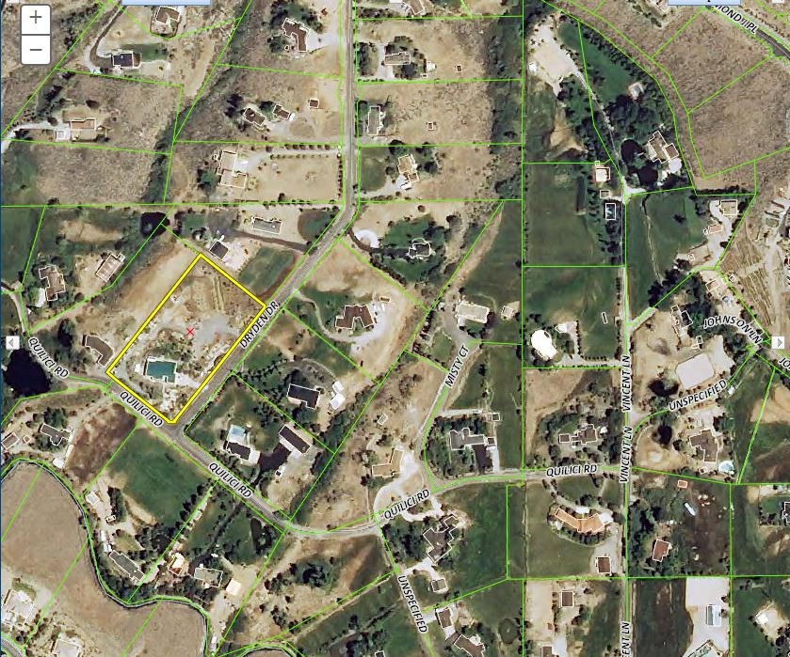
PROPOSED PROJECT SITE
Notes:
Here is the termination of Dryden at Quilici.
The County maintained portion of Quilci is only 749 feet long.
USE POINTER TO EMPHSIZE SHORT 740 FT.
To the west, it turns into a private driveway.
To the east, it turns into a dirt road not owned or maintained by Washoe County.

Slide 5
WASHOE COUNTY CODE
Article 308 - HOME OCCUPATIONS
Section 110.308.00 Purpose. The purpose of this article, Article 308, Home Occupations, is to provide for business uses in association with dwellings where such uses will clearly not alter the character or appearance of the residential environment.
Section 110.308.05 Applicability. Home occupations shall be allowed in any regulatory zone which allows dwellings or has a residential unit currently on the property. Home occupations are regulated by Chapter 25 of the Washoe County Code. Home occupations are assigned to the holder of the home business license and are not appurtenant to the land or structure.
Notes:
Regardless of how this conversion of use is termed, it is still a business. The owner will not occupy the building. Everybody in the building will either be a client or employee. The facility will require a business license to operate. Lets call a spade a spade – this is actually the conversion of a residence to a pure business.
Two parts – appearance AND character. This project will greatly alter the character all the employees coming and going, the deliveries, the frequent emergency calls, and the vastly increased ambulatory pedestrian traffic on the rural road.

Slide 6
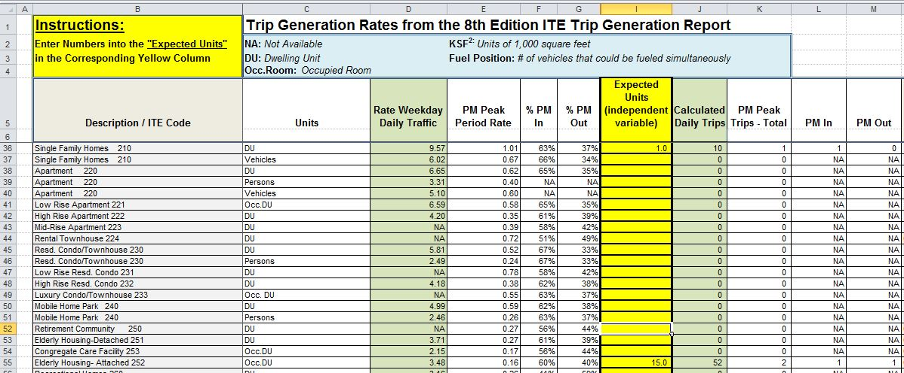
TRIP GENERATION
Notes:
On average, a normal residence generates 10 vehicle trips per day. This business will generate 52, plus 6 for employees. Almost 6 times a normal residence.

Slide 7
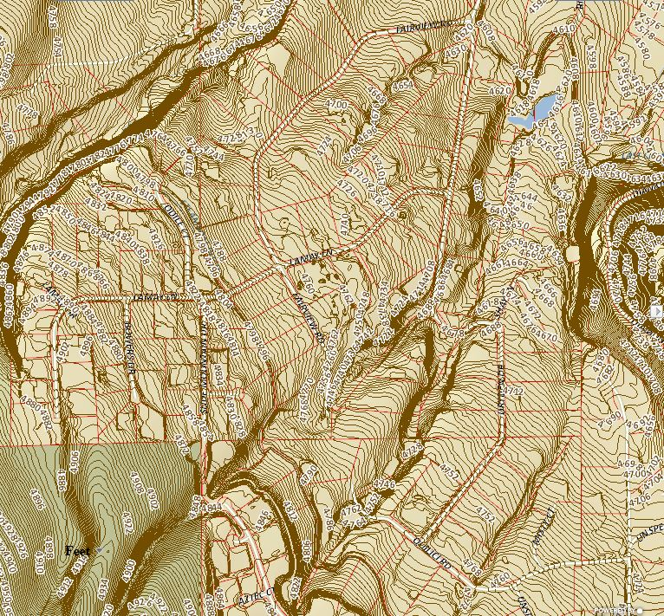
STEEP TERRAIN
Notes:
Not easy for mobility impaired to navigate

Slide 8
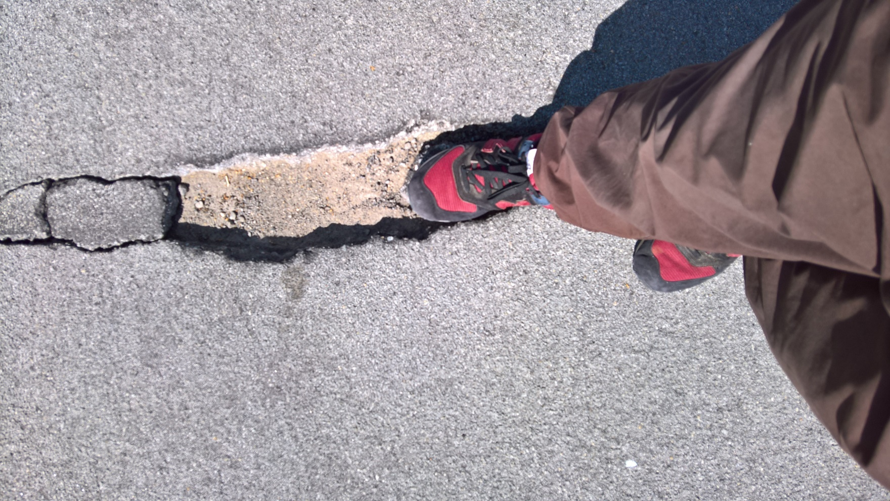
DRYDEN POOR MAINENANCE
Notes:
Dryden Drive, the sole access for this project, has been poorly maintained, having been over a dozen years since the County last did nay pavement maintenance. Consequently, the pavement is disintegrating. Here is a 24”x6” section of missing pavement.

Slide 9
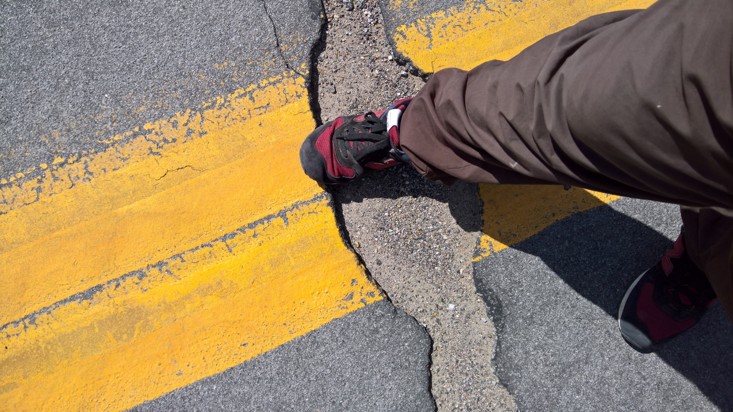
MORE POOR MAINTENANCE
Notes:
Another 36”x12” section of missing pavement. There are many more areas like this. The six-fold increase in traffic along the entire length of Dryden will only exerbate the disintegration.

Slide 10
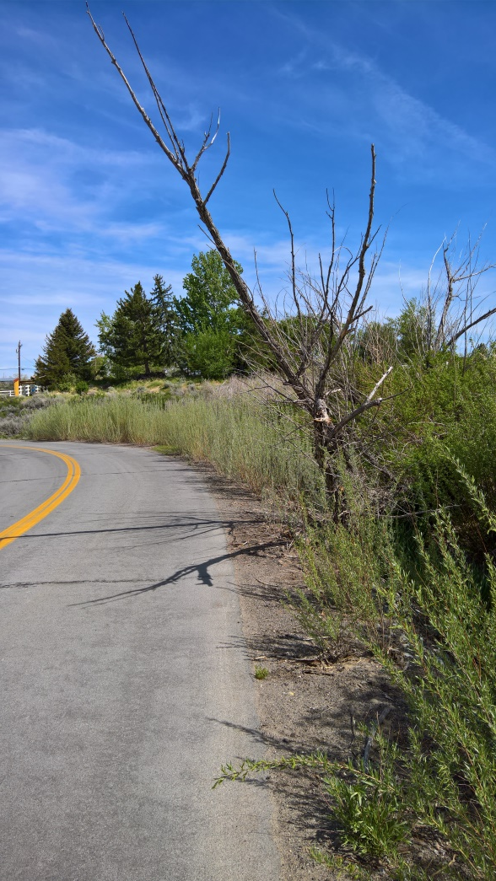
4 YEARS SINCE LAST SHOULDER WORK
Notes:
NOTE DEAD TREE HANGING 6 feet OVER PAVEMENT, WILLOWS AGAINST PAVEMENT.
Willows plug culvert under Dryden, which overtopped the road, closing it during the floods this winter, blocking the only public access for this project.

Slide 11
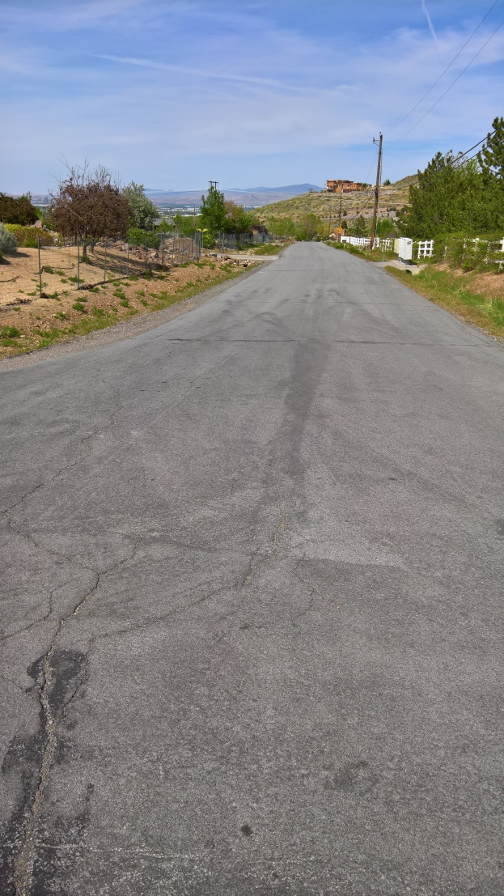
DRYDEN AT QUILICI
Notes:
Note the lack of curb, gutter and sidewalks. No fire hydrants. No on street parking and the developer is not providing any on site deliver areas. During winter, snow plowing is only on school days. When school is not in session, snow can block the road for days. Into this environment, the developer proposes to inject 15 mobility impaired but ambulatory clients. With no sidewalks, they will be perilously navigating in the middle of the road. 6% GRADE, MAILBOXES ON RT. OPPOSITE DWY. ON LT.

Slide 12
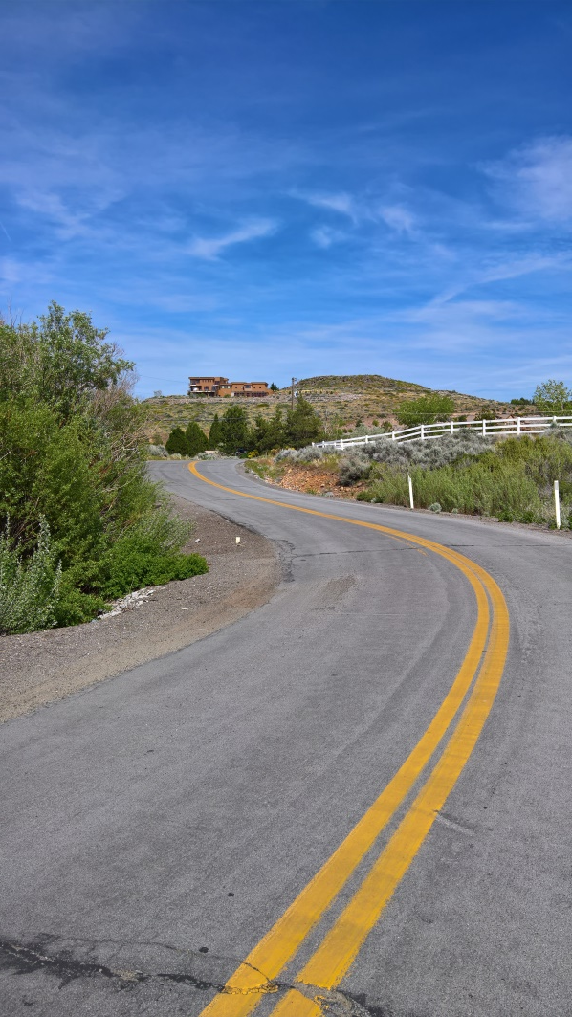
BLIND CURVES
Notes:
Heading toward Quilici on Dryden in canyon
Dryden has several blind curves and hills. Imagine a low wheel chair in the middle of the road at the top of this picture when a vehicle comes from the right around this blind corner. The result will not be pretty.
This project is inappropriate for this neighborhood because the roads cannot support it. Please deny this project.
Will everybody opposed to this project please stand up.

